Slide 1
Project: Electro-gravitational implementation of a Hermann Bondi inertial dipole
An anti-gravity bottom plate pushes a top gravity plate above it upwards.
The top gravity plate pulls the anti-gravity plate.
The result is an aircraft that will outperform any conventional plane.
Space travel will become commonplace.
No more cars or roads will be needed.
Energy can be obtained from spacetime by the “Mach principle” on the expense of the gravitational energy of far bodies of mass. If you need further reading, look for “Inertial Induction” for example. Feasible if it does not affect the orbit of the moon or the orbit of the Earth around the sun, i.e. if energy extraction is well distributed on all bodies of mass.

Slide 2
Market target: Everyone. This is big!!!
The potential of charge-based gravity and anti-gravity will enable space travel, aviation accessible to everybody and using Hermann Bodi’s inertial dipoles to extract Machian energy. Machian energy means that the relative motion of such a dipole must affect the trajectories of far bodies of mass by affecting the background metric. An example of such a theory is “Inertial Induction”.
The first goal is to achieve sustainable thrust more than the ones reported by: Andrew Neil Aurigema, Charles Raymond Buhler, "System and method for generating forces using asymmetrical electrostatic pressure", and by James W. Purvis, "PULSED E-FIELD PROPULSION SYSTEM“. Charles Buhler’s 10 milli Newtons thrust with a very small device is several orders of magnitude more than predicted by this theory’s classical limit, however, the classical limit should be replaced with analytic solutions to (4) in the paper.

Slide 3
1982 – Sam Vaknin’s idea that even energy and momentum are the result of time…
…and must come out of the principle of parsimony is correct.
Faddeev-Popov ghost theorem shows a problem with multiplicity inherent in Gauge theory. Gauge theory approach separates between particles and forces. This model seeks to unite the two. Again, the principle of parsimony is at play.

Slide 4
2003-An idea which complies with Robert Gercoh time function in a causal spacetime
It must however work in any spacetime even if the interpretation is easier in a causal spacetime. Robert Geroch proved that in a causal spacetime, a universal clock can be consistently defined – see Geroch Splitting Theorem. Why is it important? Because it reduces the number of the model’s assumptions. There is no need to invent a new scalar function.

Slide 5
Geroch function does not violate the principle of Relativity. The same maximal proper time can be measured from a Cauchy surface to every event along more than one curve. There is a magnitude but not a direction. So, there is no preferable coordinate of time.
So, what happens when the same event is accessible through multiple such curves?
How will a test clock move? Along a geodesic as expected from GR or along the gradient of the scalar function?
What does that mean in terms of physics? How does this idea differ from conventional physics?
Is the gradient of such a scalar function always geodesic? If not, then what is the action of such a gradient?

Slide 6
To allow a gradient of a scalar function not to be geodesic, an action must be defined on its Reeb class, not the usual Reeb vector. The Reeb class can be seen in the Godbilon-Vey form. The Reeb class is a 1-form and has a vector formalism too. It means non-geodesic acceleration.
There must be terms in the Euler Lagrange equations that will allow solutions in which the gradient will not have to be geodesic.

Slide 7
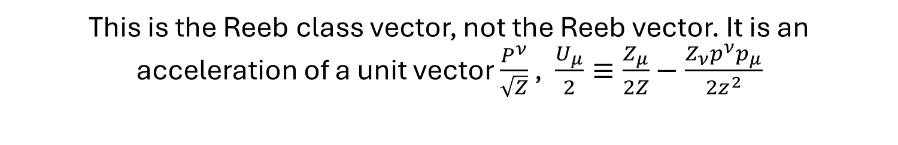
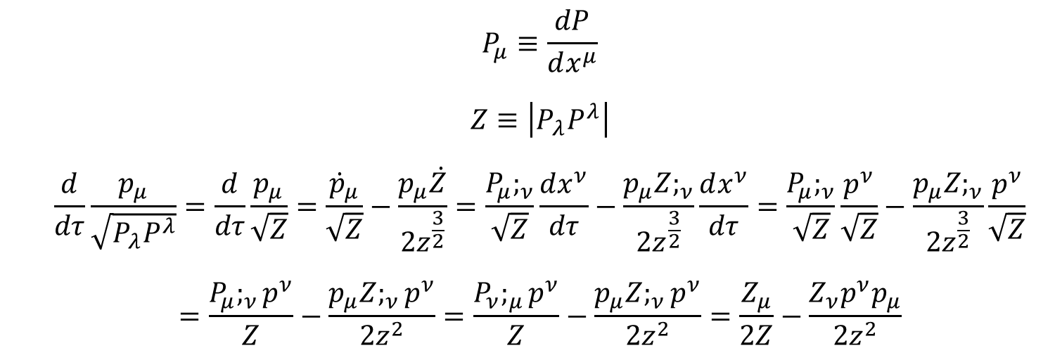
$$P_{μ}≡\frac{dP}{dx^{μ}}$$ $$Z≡\left|P_{λ}P^{λ}\right|$$ $$\frac{d}{dτ}\frac{p_{μ}}{\sqrt{P_{λ}P^{λ}}}=\frac{d}{dτ}\frac{p_{μ}}{\sqrt{Z}}=\frac{{\dot{p}}_{μ}}{\sqrt{Z}}−\frac{p_{μ}\dot{Z}}{{2z}^{\frac{3}{2}}}=\frac{P_{μ};_{ν}}{\sqrt{Z}}\frac{dx^{ν}}{dτ}−\frac{p_{μ}Z;_{ν}}{{2z}^{\frac{3}{2}}}\frac{dx^{ν}}{dτ}=\frac{P_{μ};_{ν}}{\sqrt{Z}}\frac{p^{ν}}{\sqrt{Z}}−\frac{p_{μ}Z;_{ν}}{{2z}^{\frac{3}{2}}}\frac{p^{ν}}{\sqrt{Z}}$$ $$=\frac{P_{μ};_{ν}p^{ν}}{Z}−\frac{p_{μ}Z;_{ν}p^{ν}}{{2z}^{2}}=\frac{P_{ν};_{μ}p^{ν}}{Z}−\frac{p_{μ}Z;_{ν}p^{ν}}{{2z}^{2}}=\frac{Z_{μ}}{2Z}−\frac{Z_{ν}p^{ν}p_{μ}}{{2z}^{2}}$$
This is the Reeb class vector, not the Reeb vector. It is an acceleration of a unit vector $\frac{P^{ν}}{\sqrt{Z}}$ , $\frac{U_{μ}}{2}≡\frac{Z_{μ}}{2Z}−\frac{Z_{ν}p^{ν}p_{μ}}{{2z}^{2}}$

Slide 8
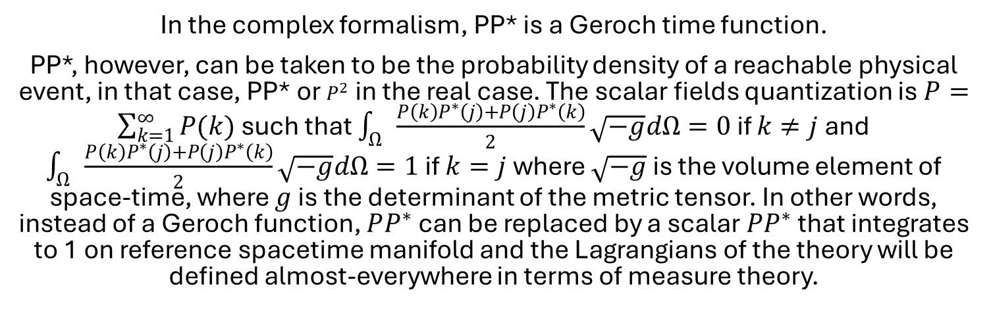
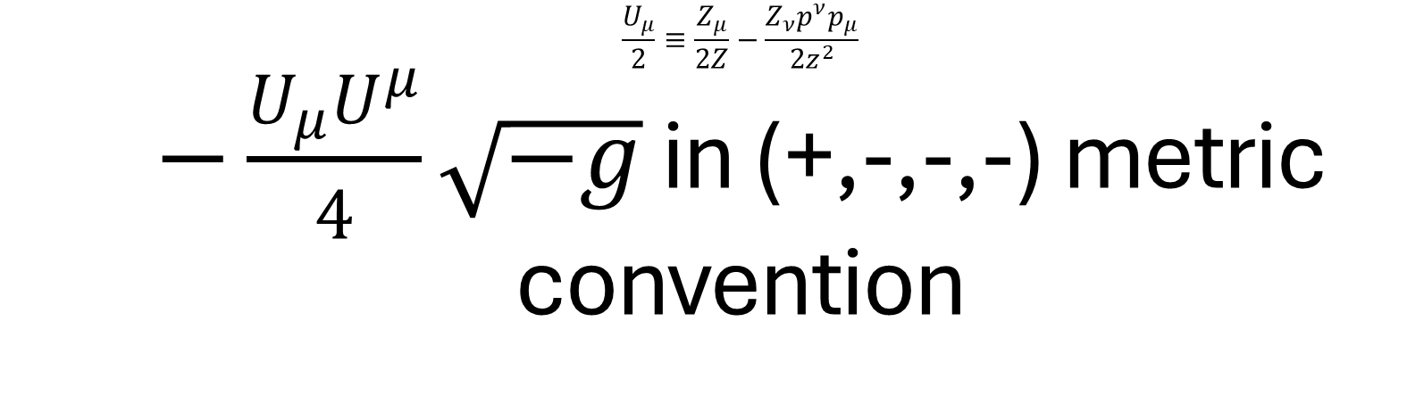
$$\frac{U_{μ}}{2}≡\frac{Z_{μ}}{2Z}−\frac{Z_{ν}p^{ν}p_{μ}}{{2z}^{2}}$$ $−\frac{U_{μ}U^{μ}}{4}\sqrt{−g}$ in (+,-,-,-) metric convention
In the complex formalism, PP* is a Geroch time function.
PP*, however, can be taken to be the probability density of a reachable physical event, in that case, PP* or $P^{2}$ in the real case. The scalar fields quantization is $P=\sum_{k=1}^{∞}{P(k)}$ such that $\int_{Ω}{\frac{P\left(k\right)P^{∗}\left(j\right)+P\left(j\right)P^{∗}\left(k\right)}{2}}\sqrt{−g}dΩ=0$ if $k≠j$ and $\int_{Ω}{\frac{P\left(k\right)P^{∗}\left(j\right)+P\left(j\right)P^{∗}\left(k\right)}{2}}\sqrt{−g}dΩ=1$ if $k=j$ where $\sqrt{−g}$ is the volume element of space-time, where $g$ is the determinant of the metric tensor. In other words, instead of a Geroch function, $PP^{∗}$ can be replaced by a scalar $PP^{∗}$ that integrates to 1 on reference spacetime manifold and the Lagrangians of the theory will be defined almost-everywhere in terms of measure theory.

Slide 9

In specific comfortable local coordinates that can be extended to 4 dimensions, there is a Tzvi Scarr – Yaakov Friedman acceleration matrix formalism Av/c =a/c^2, v/c is a unit vector, c is the speed of light:
$$A=\left(\begin{matrix}0 & −a \\ a & 0\end{matrix}\right)⟹Det\left(A\right)=−a^{2}=\frac{{U^{μ}U}_{μ}}{4}$$
in the real case with two basis vectors $\frac{P^{ν}}{\sqrt{Z}}$ and $\frac{U^{ν}}{\sqrt{\left\|U^{λ}U_{λ}\right\|}}$, where $\left\|U^{λ}U_{λ}\right\|≠0$.
$A_{μν}=\frac{U_{μ}}{2}\frac{P_{ν}}{\sqrt{Z}}−\frac{U_{ν}}{2}\frac{P_{μ}}{\sqrt{Z}}$, ${ A}_{μν}\frac{p^{ν}}{\sqrt{Z}}=\frac{U_{μ}}{2}$, where $\sqrt{Z}$ is the norm of $p^{ν}$
$$\frac{U_{μ}}{2}≡\frac{Z_{μ}}{2Z}−\frac{Z_{ν}p^{ν}p_{μ}}{{2z}^{2}}$$
And there is an immediate relation to a more known form of Scarr-Friedman acceleration: $\frac{U_{μ}}{2}=\frac{{dc^{−1}X}^{μ}}{cdτ}=\frac{a_{μ}}{c^{2}}$

Slide 10
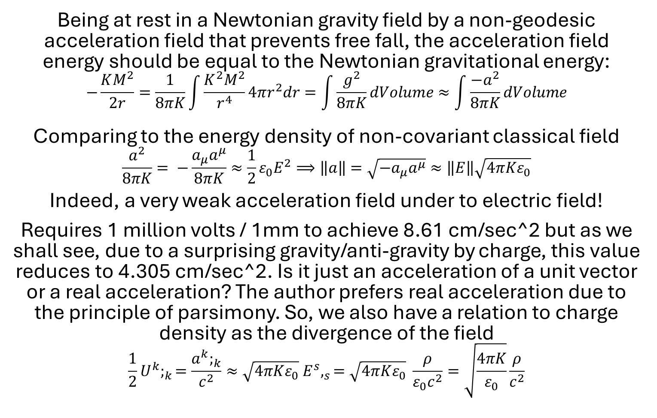
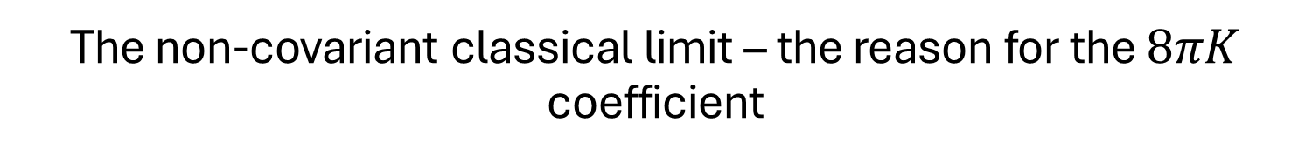
The non-covariant classical limit – the reason for the $8πK$ coefficient
Being at rest in a Newtonian gravity field by a non-geodesic acceleration field that prevents free fall, the acceleration field energy should be equal to the Newtonian gravitational energy:
$$−\frac{KM^{2}}{2r}=\frac{1}{8πK}\int{\frac{K^{2}M^{2}}{r^{4}}}4πr^{2}dr=\int{\frac{g^{2}}{8πK}}dVolume≈\int{\frac{{−a}^{2}}{8πK}}dVolume$$
Comparing to the energy density of non-covariant classical field
$$\frac{a^{2}}{8πK}= −\frac{a_{μ}a^{μ}}{8πK}≈{\frac{1}{2}ε}_{0}E^{2}⟹\left\|a\right\|=\sqrt{−a_{μ}a^{μ}}≈\left\|E\right\|\sqrt{4πKε_{0}}$$
Indeed, a very weak acceleration field under to electric field!
Requires 1 million volts / 1mm to achieve 8.61 cm/sec^2 but as we shall see, due to a surprising gravity/anti-gravity by charge, this value reduces to 4.305 cm/sec^2. Is it just an acceleration of a unit vector or a real acceleration? The author prefers real acceleration due to the principle of parsimony. So, we also have a relation to charge density as the divergence of the field
$${\frac{1}{2}U}^{k};_{k}=\frac{a^{k};_{k}}{c^{2}}≈\sqrt{4πKε_{0}} E^{s},_{s}=\sqrt{4πKε_{0}} \frac{ρ}{ε_{0}c^{2}}=\sqrt{\frac{4πK}{ε_{0}}}\frac{ρ}{c^{2}}$$

Slide 11
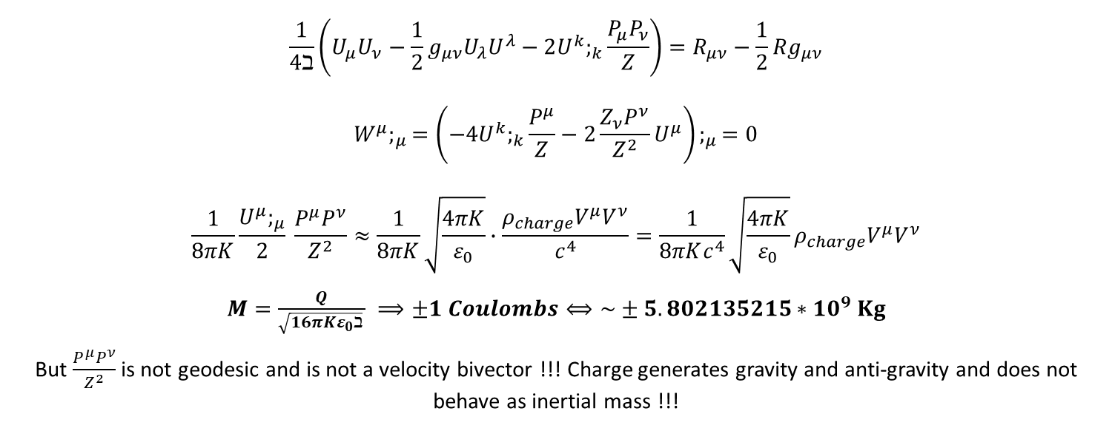
The Euler Lagrange equations of the minimum action yield a very surprising result
$$\frac{1}{4ℶ}\left(U_{μ}U_{ν}−\frac{1}{2}g_{μν}U_{λ}U^{λ}−2U^{k};_{k}\frac{P_{μ}P_{ν}}{Z}\right)=R_{μν}−\frac{1}{2}Rg_{μν}$$
$$W^{μ};_{μ}=\left(−4U^{k};_{k}\frac{P^{μ}}{Z}−2\frac{Z_{ν}P^{ν}}{Z^{2}}U^{μ}\right);_{μ}=0$$
$$\frac{1}{8πK}\frac{U^{μ};_{μ}}{2} \frac{P^{μ}P^{ν}}{Z^{2}}≈\frac{1}{8πK}\sqrt{\frac{4πK}{ε_{0}}}∙\frac{ρ_{charge}V^{μ}V^{ν}}{c^{4}}=\frac{1}{8πKc^{4}}\sqrt{\frac{4πK}{ε_{0}}}ρ_{charge}V^{μ}V^{ν}$$
$M=\frac{Q}{\sqrt{{16πKε}_{0}ℶ} } ⟹±1 Coulombs⟺\sim ±5.802135215∗{10}^{9} Kg$
But $\frac{P^{μ}P^{ν}}{Z^{2}}$ is not geodesic and is not a velocity bivector !!! Charge generates gravity and anti-gravity and does not behave as inertial mass !!!

Slide 12
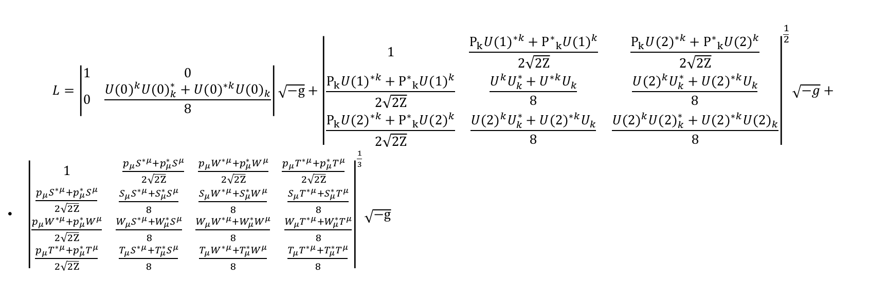
The theory is easily extended to 2, 3 and even 4 Reeb class vectors (not the usual Reeb vectors). In the 2, 3 case, there is a local gradient of a Geroch function or an event function
$$L=\left|\begin{matrix}1 & 0 \\ 0 & \frac{{U(0)}^{k}{U(0)}_{k}^{∗}+{U(0)}^{∗k}{U(0)}_{k}}{8}\end{matrix}\right|\sqrt{−g}+{\left|\begin{matrix}1 & \frac{P_{k}{U(1)}^{∗k}+{P^{∗}}_{k}{U(1)}^{k}}{2\sqrt{2Z}} & \frac{P_{k}{U(2)}^{∗k}+{P^{∗}}_{k}{U(2)}^{k}}{2\sqrt{2Z}} \\ \frac{P_{k}{U(1)}^{∗k}+{P^{∗}}_{k}{U(1)}^{k}}{2\sqrt{2Z}} & \frac{U^{k}U_{k}^{∗}+U^{∗k}U_{k}}{8} & \frac{{U(2)}^{k}U_{k}^{∗}+{U(2)}^{∗k}U_{k}}{8} \\ \frac{P_{k}{U(2)}^{∗k}+{P^{∗}}_{k}{U(2)}^{k}}{2\sqrt{2Z}} & \frac{{U(2)}^{k}U_{k}^{∗}+{U(2)}^{∗k}U_{k}}{8} & \frac{{U(2)}^{k}{U(2)}_{k}^{∗}+{U(2)}^{∗k}{U(2)}_{k}}{8}\end{matrix}\right|}^{\frac{1}{2}}\sqrt{−g}+$$
${\left|\begin{matrix}1 & \begin{matrix}\frac{p_{μ}S^{∗μ}+p_{μ}^{∗}S^{μ}}{2\sqrt{2Z}} & \frac{p_{μ}W^{∗μ}+p_{μ}^{∗}W^{μ}}{2\sqrt{2Z}} & \frac{p_{μ}T^{∗μ}+p_{μ}^{∗}T^{μ}}{2\sqrt{2Z}}\end{matrix} \\ \begin{matrix}\frac{p_{μ}S^{∗μ}+p_{μ}^{∗}S^{μ}}{2\sqrt{2Z}} \\ \frac{p_{μ}W^{∗μ}+p_{μ}^{∗}W^{μ}}{2\sqrt{2Z}} \\ \frac{p_{μ}T^{∗μ}+p_{μ}^{∗}T^{μ}}{2\sqrt{2Z}}\end{matrix} & \begin{matrix}\frac{S_{μ}S^{∗μ}+S_{μ}^{∗}S^{μ}}{8} & \frac{S_{μ}W^{∗μ}+S_{μ}^{∗}W^{μ}}{8} & \frac{S_{μ}T^{∗μ}+S_{μ}^{∗}T^{μ}}{8} \\ \frac{W_{μ}S^{∗μ}+W_{μ}^{∗}S^{μ}}{8} & \frac{W_{μ}W^{∗μ}+W_{μ}^{∗}W^{μ}}{8} & \frac{W_{μ}T^{∗μ}+W_{μ}^{∗}T^{μ}}{8} \\ \frac{T_{μ}S^{∗μ}+T_{μ}^{∗}S^{μ}}{8} & \frac{T_{μ}W^{∗μ}+T_{μ}^{∗}W^{μ}}{8} & \frac{T_{μ}T^{∗μ}+T_{μ}^{∗}T^{μ}}{8}\end{matrix}\end{matrix}\right|}^{\frac{1}{3}}\sqrt{−g}$

Slide 13
The full mathematical formalism is very interesting and offers time asymmetry!
See: Theorem 0: Time asymmetry special theorem (Suchard - Vaknin)

Slide 14
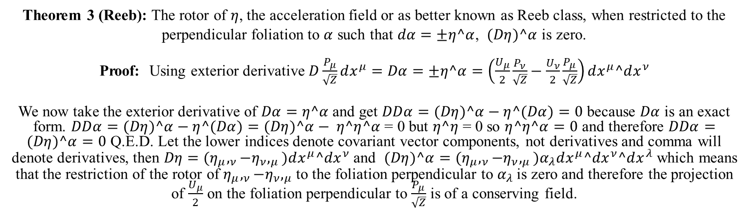
A very important theorem by Georges Henry Reeb means the field has drains and sources as expected from charge when reduced to 3D
Theorem 3 (Reeb): The rotor of $η$, the acceleration field or as better known as Reeb class, when restricted to the perpendicular foliation to $α$ such that $dα=±η^α$, $(Dη)^α$ is zero.
Proof: Using exterior derivative $D\frac{P_{μ}}{\sqrt{Z}}dx^{μ}=Dα=±η^α=\left(\frac{U_{μ}}{2}\frac{P_{ν}}{\sqrt{Z}}−\frac{U_{ν}}{2}\frac{P_{μ}}{\sqrt{Z}}\right)dx^{μ}^dx^{ν}$
We now take the exterior derivative of $Dα=η^α$ and get $DDα=(Dη)^α−η^(Dα)=0$ because $Dα$ is an exact form. $DDα=(Dη)^α−η^(Dα)=(Dη)^α− η^η^α$ = 0 but $η^η$ = 0 so $η^η^α=0$ and therefore $DDα=(Dη)^α=0$ Q.E.D. Let the lower indices denote covariant vector components, not derivatives and comma will denote derivatives, then $Dη={(η}_{μ},_{ν}−η_{ν},_{μ})dx^{μ}^dx^{ν}$ and $(Dη)^α={(η}_{μ},_{ν}−η_{ν},_{μ})α_{λ}dx^{μ}^dx^{ν}^dx^{λ}$ which means that the restriction of the rotor of $η_{μ},_{ν}−η_{ν},_{μ}$ to the foliation perpendicular to $α_{λ}$ is zero and therefore the projection of $\frac{U_{μ}}{2}$ on the foliation perpendicular to $\frac{P_{μ}}{\sqrt{Z}}$ is of a conserving field.

Slide 15
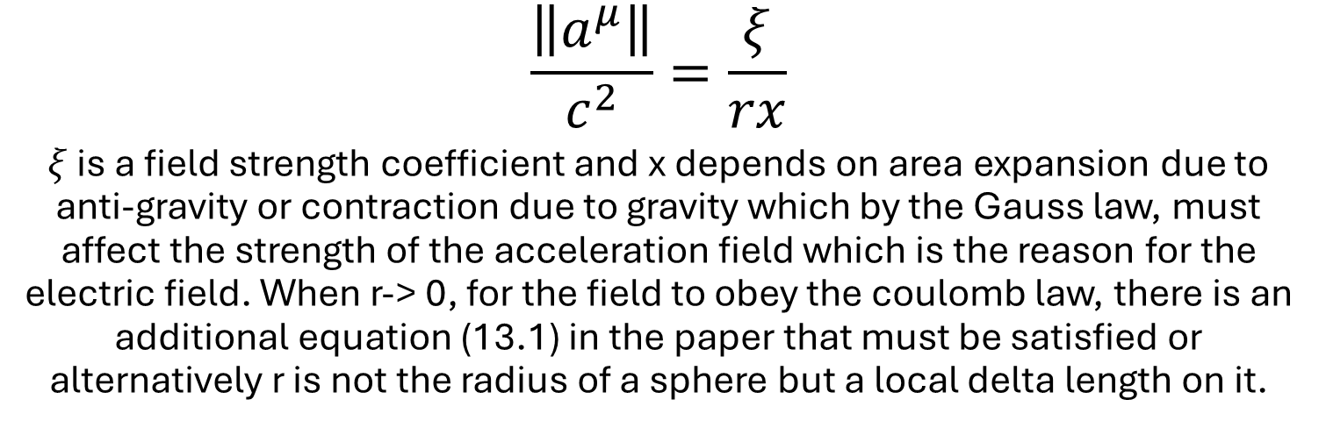
A logical assumption as r -> 0 is
$$\frac{\left\|a^{μ}\right\|}{c^{2}}=\frac{ξ}{rx}$$
$ξ$ is a field strength coefficient and x depends on area expansion due to anti-gravity or contraction due to gravity which by the Gauss law, must affect the strength of the acceleration field which is the reason for the electric field. When r-> 0, for the field to obey the coulomb law, there is an additional equation (13.1) in the paper that must be satisfied or alternatively r is not the radius of a sphere but a local delta length on it.

Slide 16
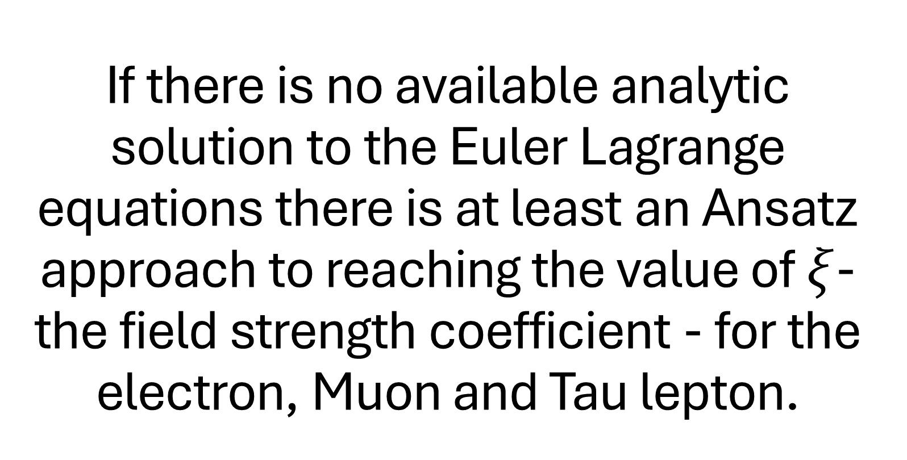
If there is no available analytic solution to the Euler Lagrange equations there is at least an Ansatz approach to reaching the value of $ξ$-the field strength coefficient - for the electron, Muon and Tau lepton.
The idea is to see how the equation behaves around small radii r. r can also be interpreted as a small delta distance from a sphere with a much larger radius than r in local coordinates.

Slide 17
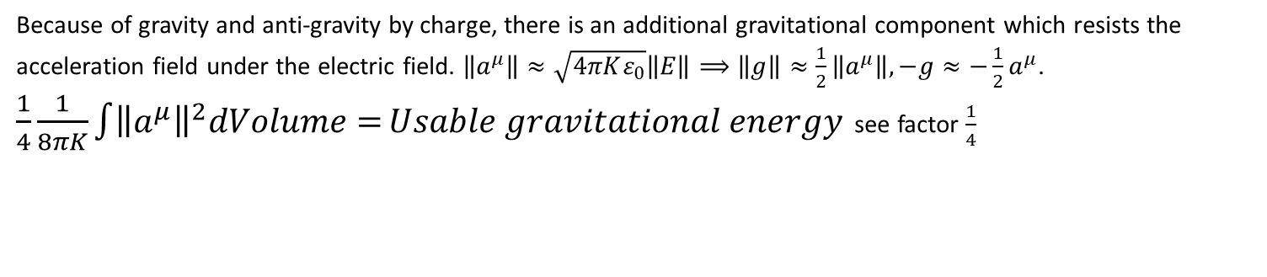
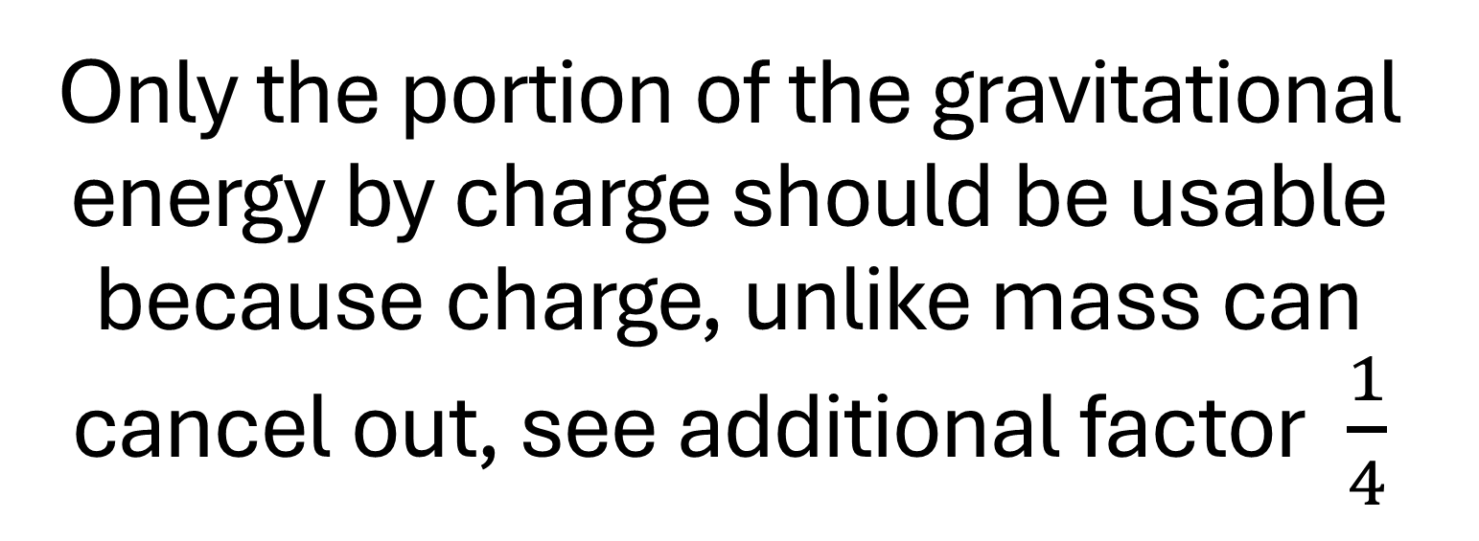
Only the portion of the gravitational energy by charge should be usable because charge, unlike mass can cancel out, see additional factor $\frac{1}{4}$
Because of gravity and anti-gravity by charge, there is an additional gravitational component which resists the acceleration field under the electric field. $\left\|a^{μ}\right\|≈\sqrt{4πKε_{0}}\left\|E\right\|⟹\left\|g\right\|≈\frac{1}{2}\left\|a^{μ}\right\|, −g≈−\frac{1}{2}a^{μ}$. $\frac{1}{4}\frac{1}{8πK}\int{{\left\|a^{μ}\right\|}^{2}dVolume=}Usable gravitational energy$ see factor $\frac{1}{4}$

Slide 18
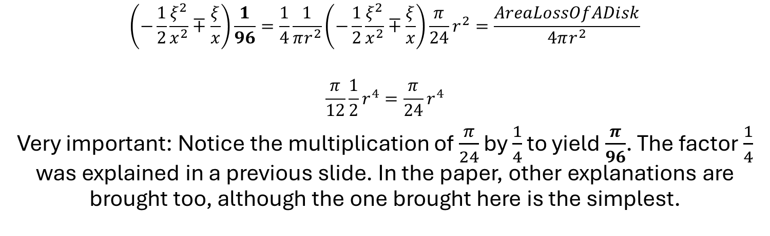

$$|\frac{U_{λ}U^{λ}}{4}|≅ξ^{2}\frac{1}{r^{2}}$$
$$\left(−\frac{1}{2}\frac{ξ^{2}}{x^{2}}∓\frac{ξ}{x}\right)\frac{1}{96}=\frac{1}{4}\frac{1}{πr^{2}}\left(−\frac{1}{2}\frac{ξ^{2}}{x^{2}}∓\frac{ξ}{x}\right)\frac{π}{24}r^{2}=\frac{AreaLossOfADisk}{4πr^{2}}$$
$$\frac{π}{12}\frac{1}{2}r^{4}=\frac{π}{24}r^{4}$$
Very important: Notice the multiplication of $\frac{π}{24}$ by $\frac{1}{4}$ to yield $\frac{π}{96}$. The factor $\frac{1}{4}$ was explained in a previous slide. In the paper, other explanations are brought too, although the one brought here is the simplest.

Slide 19
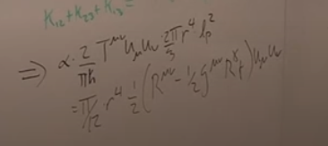
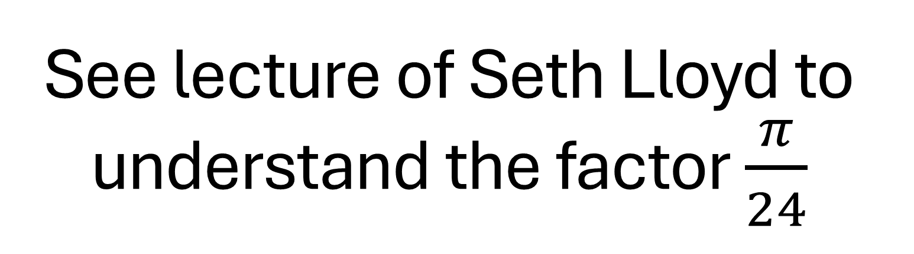
See lecture of Seth Lloyd to understand the factor $\frac{π}{24}$

Slide 20
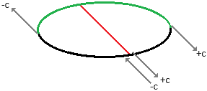
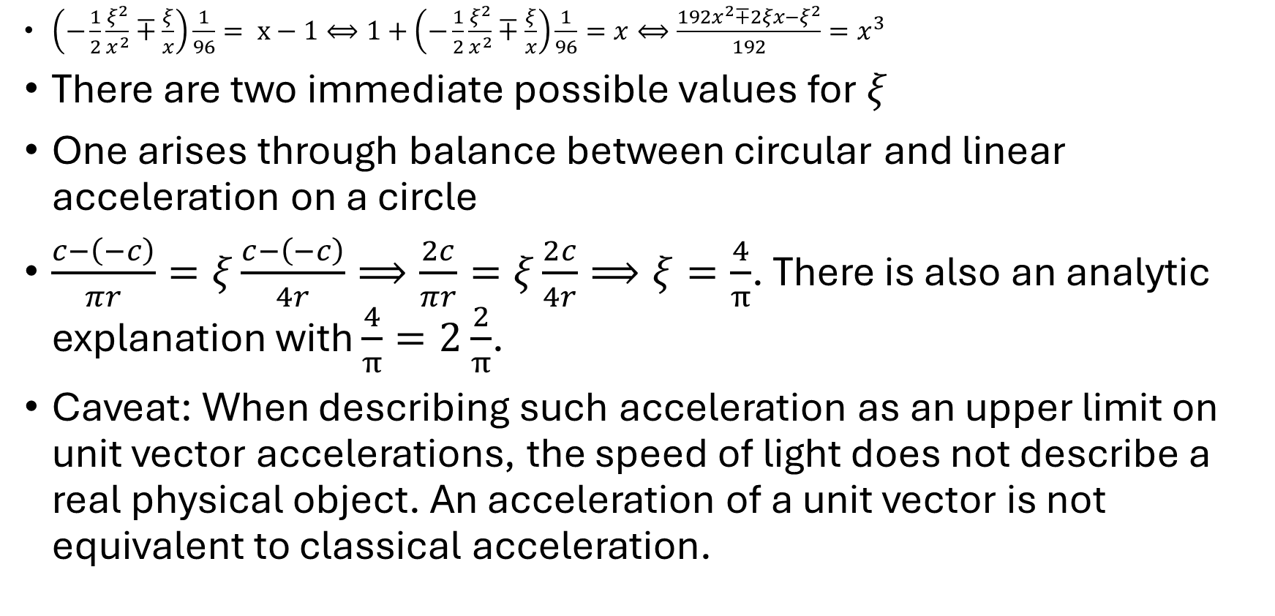
Polynomial equations arise for negative charge and for positive charge. They describe the ratio between expanded/contracted area and flat area
$\left(−\frac{1}{2}\frac{ξ^{2}}{x^{2}}∓\frac{ξ}{x}\right)\frac{1}{96}= x−1⟺1+\left(−\frac{1}{2}\frac{ξ^{2}}{x^{2}}∓\frac{ξ}{x}\right)\frac{1}{96}=x⟺\frac{{192x}^{2}∓2ξx−ξ^{2}}{192}=x^{3}$
There are two immediate possible values for $ξ$
One arises through balance between circular and linear acceleration on a circle
$\frac{c−\left(−c\right)}{πr}=ξ\frac{c−\left(−c\right)}{4r}⟹\frac{2c}{πr}=ξ\frac{2c}{4r}⟹ξ=\frac{4}{π}$. There is also an analytic explanation with $\frac{4}{π}=2$ $\frac{2}{π}$.
Caveat: When describing such acceleration as an upper limit on unit vector accelerations, the speed of light does not describe a real physical object. An acceleration of a unit vector is not equivalent to classical acceleration.

Slide 21
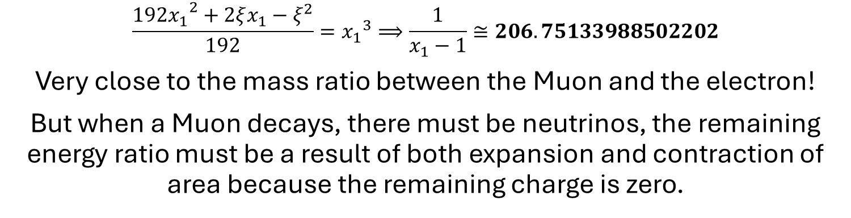
For a negative charge
$$\frac{{192x_{1}}^{2}+2ξx_{1}−ξ^{2}}{192}={x_{1}}^{3}⟹\frac{1}{x_{1}−1}≅206.75133988502202$$
Very close to the mass ratio between the Muon and the electron!
But when a Muon decays, there must be neutrinos, the remaining energy ratio must be a result of both expansion and contraction of area because the remaining charge is zero.

Slide 22
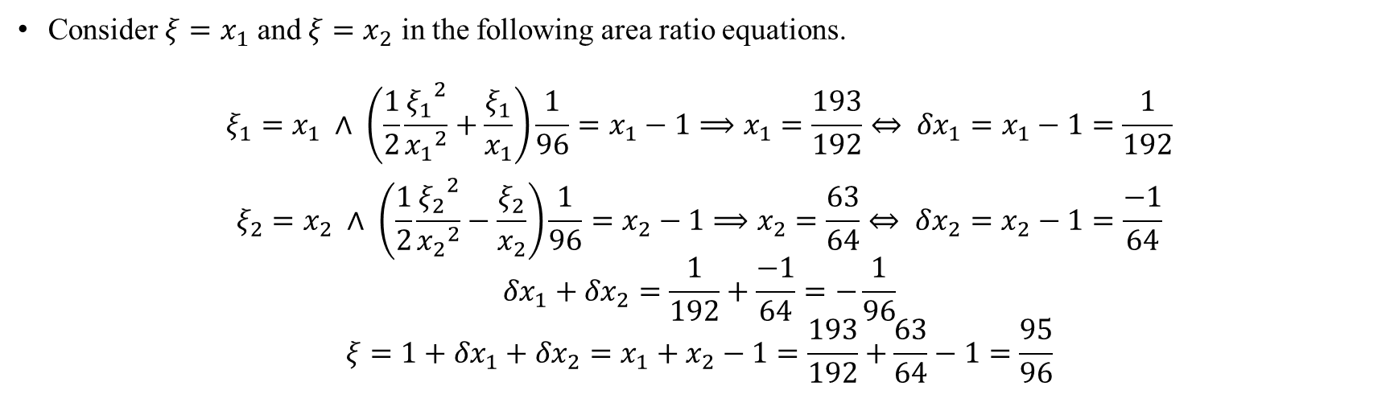

The sum of stable ground states $ξ=\frac{95}{96}$
Consider $ξ=x_{1}$ and $ξ=x_{2}$ in the following area ratio equations.
$$ξ_{1}=x_{1} ∧ \left(\frac{1}{2}\frac{{ξ_{1}}^{2}}{{x_{1}}^{2}}+\frac{ξ_{1}}{x_{1}}\right)\frac{1}{96}=x_{1}−1⟹x_{1}=\frac{193}{192}⇔ {δx}_{1}=x_{1}−1=\frac{1}{192}$$
$$ξ_{2}=x_{2} ∧ \left(\frac{1}{2}\frac{{ξ_{2}}^{2}}{{x_{2}}^{2}}−\frac{ξ_{2}}{x_{2}}\right)\frac{1}{96}=x_{2}−1⟹x_{2}=\frac{63}{64}⇔ δx_{2}=x_{2}−1=\frac{−1}{64}$$
$${δx}_{1}+{δx}_{2}=\frac{1}{192}+\frac{−1}{64}=−\frac{1}{96}$$
$$ξ=1+{δx}_{1}+{δx}_{2}=x_{1}+x_{2}−1=\frac{193}{192}+\frac{63}{64}−1=\frac{95}{96}$$

Slide 23
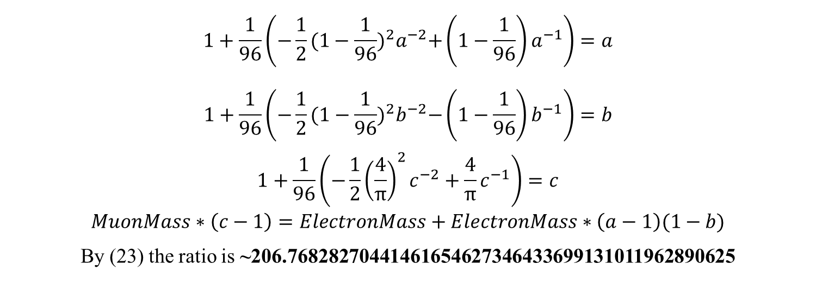
The mass ratio between the Muon and the electron
$$1+\frac{1}{96}\left(−\frac{1}{2}{({1−\frac{1}{96})}^{2}a}^{−2}+\left(1−\frac{1}{96}\right)a^{−1}\right)=a$$
$$1+\frac{1}{96}\left(−\frac{1}{2}{({1−\frac{1}{96})}^{2}b}^{−2}−\left(1−\frac{1}{96}\right)b^{−1}\right)=b$$
$$1+\frac{1}{96}\left(−\frac{1}{2}{\left(\frac{4}{π}\right)}^{2}c^{−2}+{\frac{4}{π}c}^{−1}\right)=c$$
$$MuonMass∗\left(c−1\right)=ElectronMass+ElectronMass∗\left(a−1\right)(1−b)$$
By (23) the ratio is ~206.76828270441461654627346433699131011962890625

Slide 24
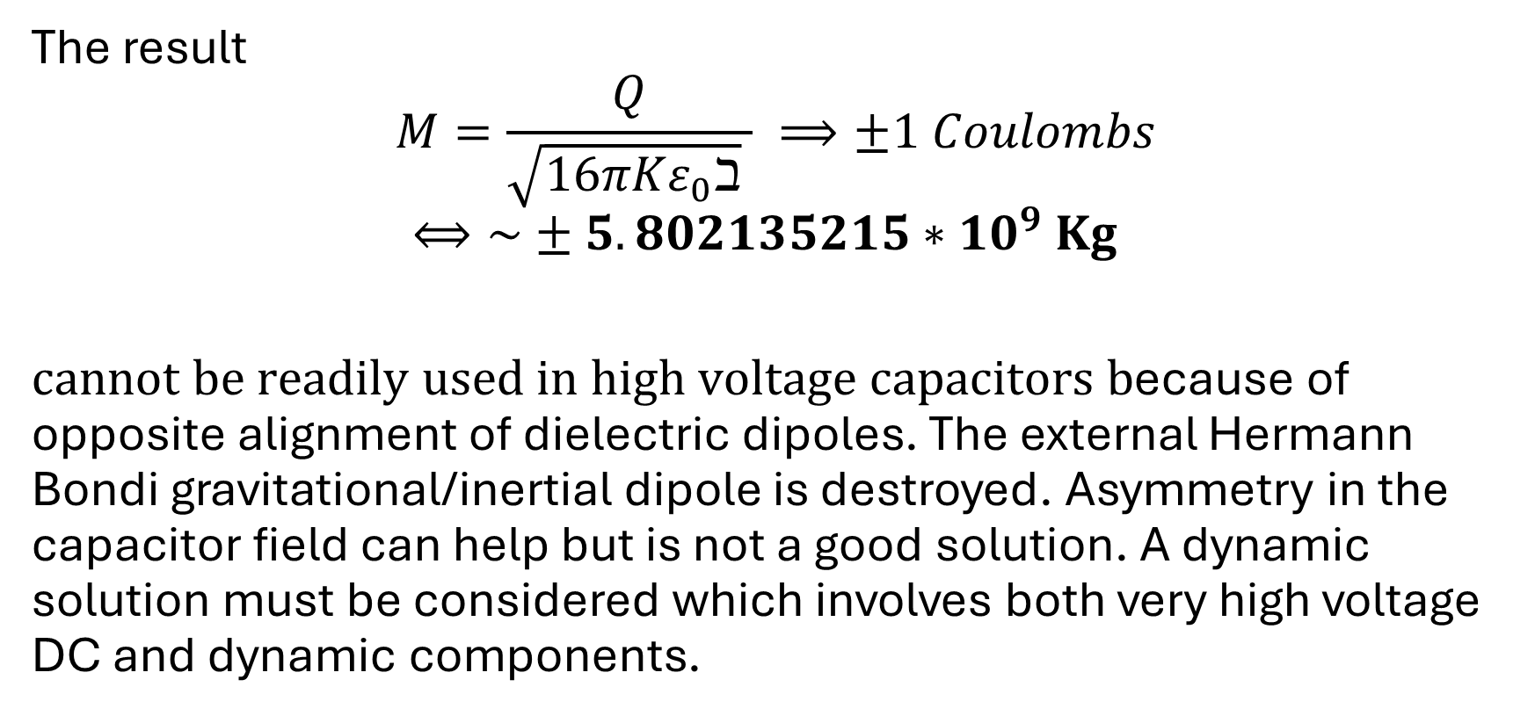
There is much more but it is important to focus on technology
The result
$$M=\frac{Q}{\sqrt{{16πKε}_{0}ℶ} } ⟹±1 Coulombs$$
$$⟺\sim ±5.802135215∗{10}^{9} Kg$$
$cannot be readily used in high voltage capacitors b$ecause of opposite alignment of dielectric dipoles. The external Hermann Bondi gravitational/inertial dipole is destroyed. Asymmetry in the capacitor field can help but is not a good solution. A dynamic solution must be considered which involves both very high voltage DC and dynamic components.

Slide 25
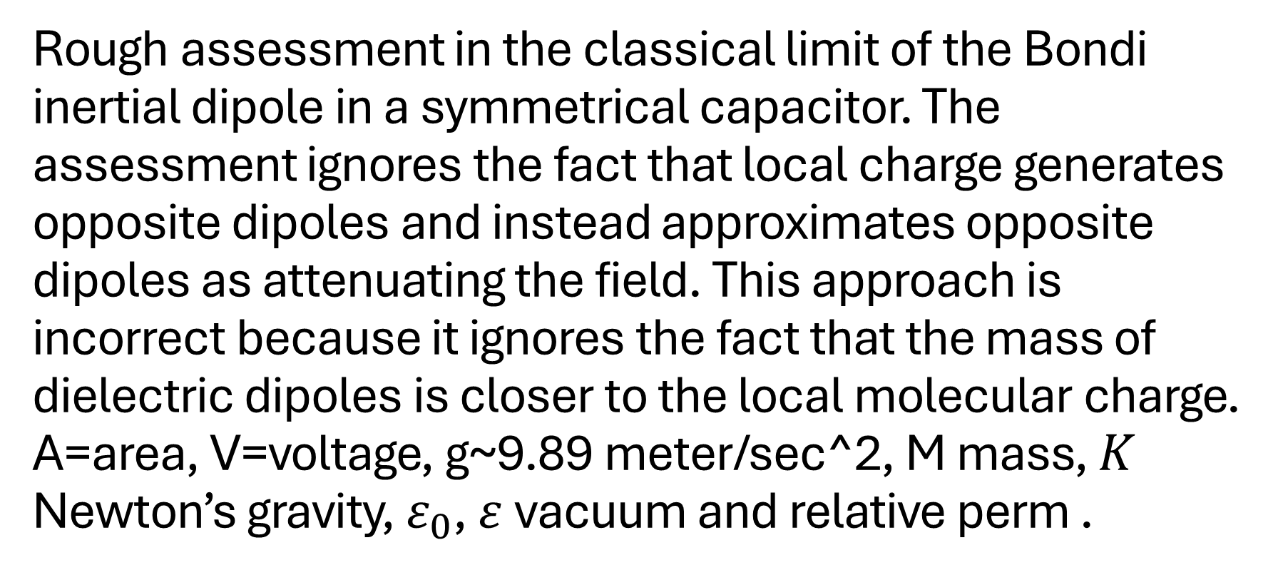
Rough assessment in the classical limit of the Bondi inertial dipole in a symmetrical capacitor. The assessment ignores the fact that local charge generates opposite dipoles and instead approximates opposite dipoles as attenuating the field. This approach is incorrect because it ignores the fact that the mass of dielectric dipoles is closer to the local molecular charge. A=area, V=voltage, g~9.89 meter/sec^2, M mass, $K$ Newton’s gravity, $ε_{0}$, $ε$ vacuum and relative perm .
$$a≅\frac{4πKQ}{A∗ε∗\sqrt{16πKε_{0}}}=\frac{V}{d}∗\sqrt{πKε_{0}}⟹δWeight≅\frac{V}{d}∗\frac{M_{dielectric}}{g}\sqrt{πKε_{0}}=\frac{VρA}{g}\sqrt{πKε_{0}}$$

Slide 26
Very rough classical limit assessment with the mentioned problem
Suppose we have a high voltage ceramic capacitor of 1000Pf of Ta2O5 [16] with each plate area 1cm² which is charged by 10,000 volts. The permittivity of vacuum is about 8.8541878128 * 10⁻¹² Farads*meter⁻¹. So we can calculate the distance d between the plates, 8.8541878128 * 10⁻¹² Farads * metere⁻¹ * 10⁻⁴ meters^{2 *} d⁻¹ * 25 = 10⁻⁹ Farads. That means d ~ 0.22135469532 * 10⁻¹ mm or d ~ 0.22135469532 * 10⁻² cm. Now we take into account the weight density of the Ta2O5 which is 8.2 grams perm 1cm³ volume. So we have 8.2 * 1cm * 1cm * 0.22135469532 * 10⁻² cm = 0.01815108501624 grams. At 10000 volts the weight loss is of a portion of 0.04960602477676315711411588216388 of the weight of the dielectric material and the inertial dipole is attenuated by the relative dielectric constant 25 just as the electric field is. So we have 0.01815108501624 grams * 0.04960602477676315711411588216388 * 25^{-1 ~} ~3.60161*10⁻⁵ grams weight loss. This estimate can be much lower in a multilayered capacitor where fields cancel out or when the dielectric constant is higher and the dipoles density is not uniform.

Slide 27
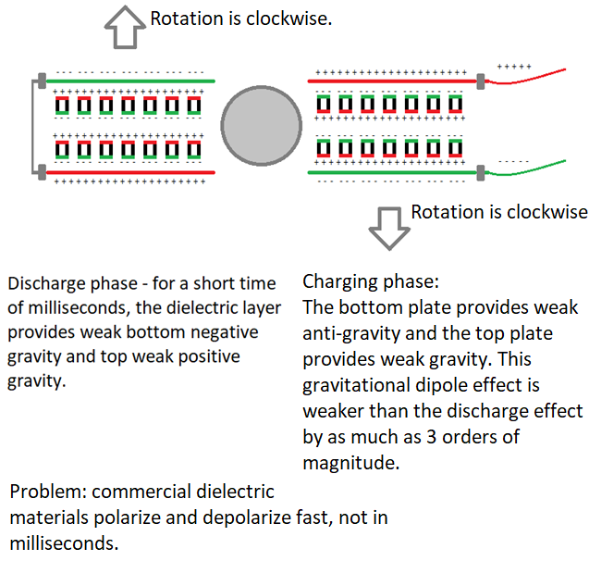
Not really a remedy but maybe a POC with slow responding dielectric, if it exists, can use the opposite dielectric alignment, especially in capacitor discharge, to generate a gravitational dipole that will not be cancelled out. Other solutions may involve RF frequencies. DC alone is insufficient!

Slide 28
Summary
It is required to use the outcome of this theory to reach a breakthrough propulsion and energy extraction technology.
If funding occurs, the starting point will be the second preferred embodiment of patent application 16/177167 combined with using high voltage DC and AC components to achieve the following:
Sustainable Hermann Bondi inertial dipole.
Build an electro-gravitational drone.

Slide 29
End
Thank you.

